Slide 1


Green University of Bangladesh (GUB)
Dept. of Computer Science and Engineering
Course Name:
CSE 104: Structured Programming Lab
Project Name:
Office Management System
Submitted to:
Submitted by:
Tanpia Tasnim,
Lecturer of CSE,
Green University of Bangladesh.
Kazi Hasnayeen Emad, ID: 191902025,
Dept. of CSE,
Green University of Bangladesh.
Date of Submission:
August 27, 2019

Slide 2
Office Management System
Introduction:
Office Management System is based on the concept to generate the Employee’s records and to add their records and update it. Here User can add their Employee’s details safely and it’s not time consuming. This System makes easy to store records of each and every employees. The whole project is designed in ‘C’ language and different variables and strings have been used for the development of this project. We have also used Binary File Operation to keep all record saved. This project is easy to operate and understand by the users.
Features:
Proper Log-In System.
Easy To Add, List ,Modify And Delete Records.
Password Protected.
Tools:
Virtual Studio Code.
Language Used:
Programming C.
Objective:
In this world of growing technologies everything has been computerized. With large number of work opportunities the Human workforce has increased. Thus there is a need of a system which can handle the data of such a large number of Employees in an organization. This project simplifies the task of maintain records because of its user friendly nature.
Background:
In this world of growing technologies everything has been computerized. With large number of work opportunities the Human workforce has increased. Some of the office use Microsoft Excel to track their Employee data. Due to increasing population, the excel data base becomes a slow medium to keep and track data. So we realize that there is a need for a better system.
Scope:
The system will keep information about an Employee’s personal details like name, age, salary, address. Storing updating and retrieving in a fast and accurate way.

Slide 3
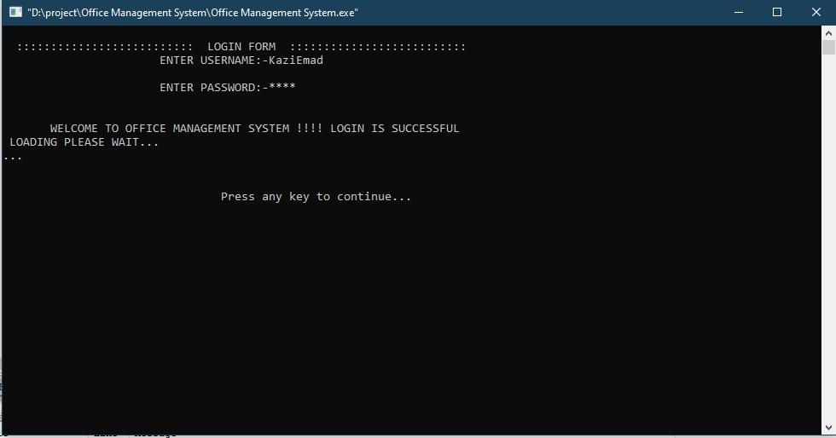
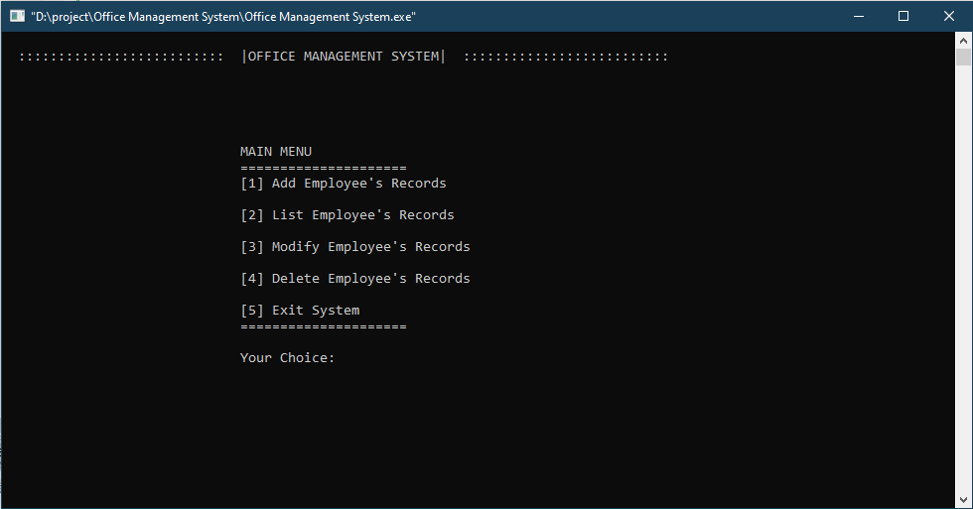
System Implimentation:
Figure 1:
This figure in below is the opening part of the program. You have to give user id and password to login.
Figure 2:
This figure in below is the Main Menu of the the program.

Slide 4
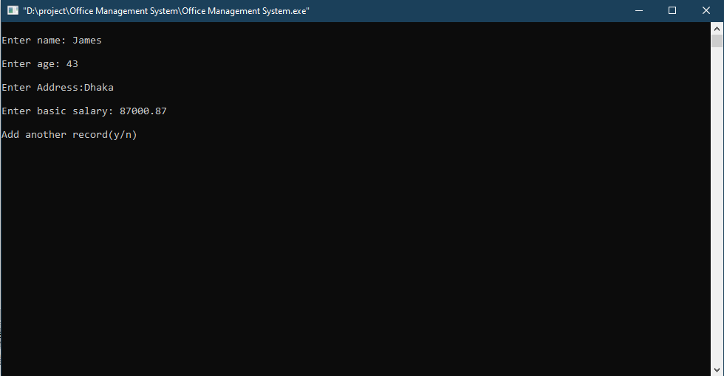
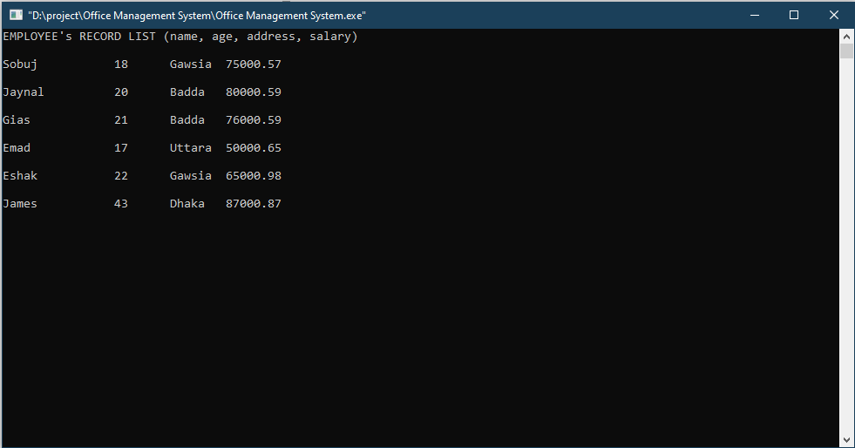
Figure 3:
This figure in below shows the “Add Employee’s Record” option.
Figure 4:
This figure in below shows the “List Employee’s Record” option.

Slide 5
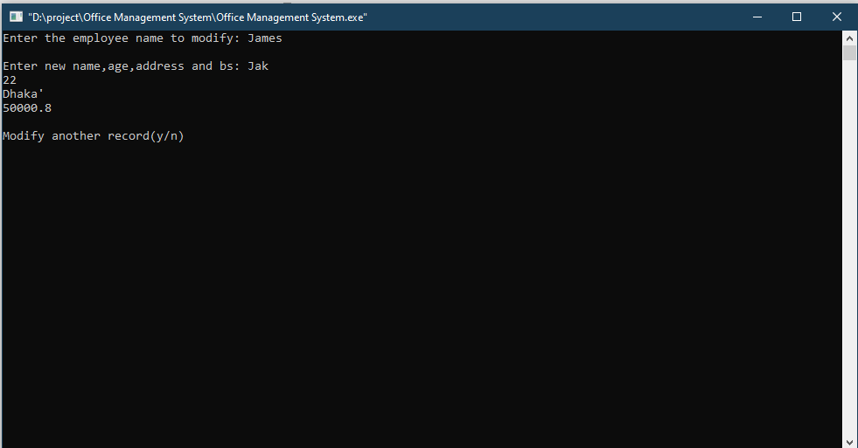
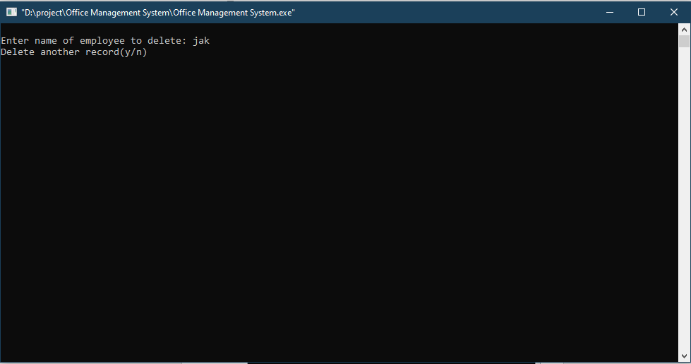
Figure 5:
This figure in below shows the “Modify Employee’s Record” option. Here I’m modifying James to Jak.
Figure 6:
This figure in below shows the “Delete Employee’s Record” option. I’m deleting Jak form the list.

Slide 6
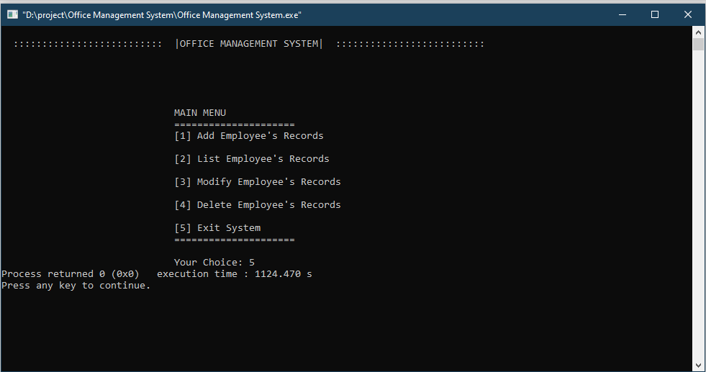
Figure 7:
This figure in below shows the “Exit System” option.
Conclusion:
Great skills have been achieved during the development of this project, time management being one of them, research in various areas of c programming and at the end of the day it can be said that the task has been a great success incorporated with extraordinary challenges. All in all the sleepless nights, stressful days and hard work have paid off and besides some good moments were also experienced. These experiences will be used for ever.

